Slide 1

Van Rental Fortune Telling
By: Phillip Vargas

Slide 2
Background
A National Van Rental company’s expenses are variables based on demand. The largest and most volatile expense is the fleet. If the fleet is too large massive quantities of car notes are paid on unused vans or if fleet is too small revenues and market share is missed.
Questions to solve this business problem:
What are the peak Days? Weeks? Months? Quarters? Season?
What are the slow periods? How long do they last?
How often is the company under fleeted?
How often is the company over fleeted?
Can the company optimize fleeting patterns?
Set Clear Measurement Priorities
A) Decide What To Measure: Sales Demand
B) Decide How To Measure It: Daily Contract Counts
https://www.bigskyassociates.com/blog/bid/372186/The-Data-Analysis-Process-5-Steps-To-Better-Decision-Making

Slide 3
Goal
Build an accurate model to predict van rental sales demand.
Help the Van Rental company optimize variable expenses.

Slide 4
Data
Raw Data: CSV
DataFrame: (Rows, Columns)
2019 Revenue: (106494, 171)
2018 Revenue: (106563, 165)
2017 Revenue: (96909, 159)
Prepped Data:
Total Days: 1,095
Total Sales Count: 305,353
Univariate (one variable)
Daily
DayofWeek
Weekly
Monthly
Quarterly
Multivariate (multiple variables)
Monthly – DayofWeek

Slide 5
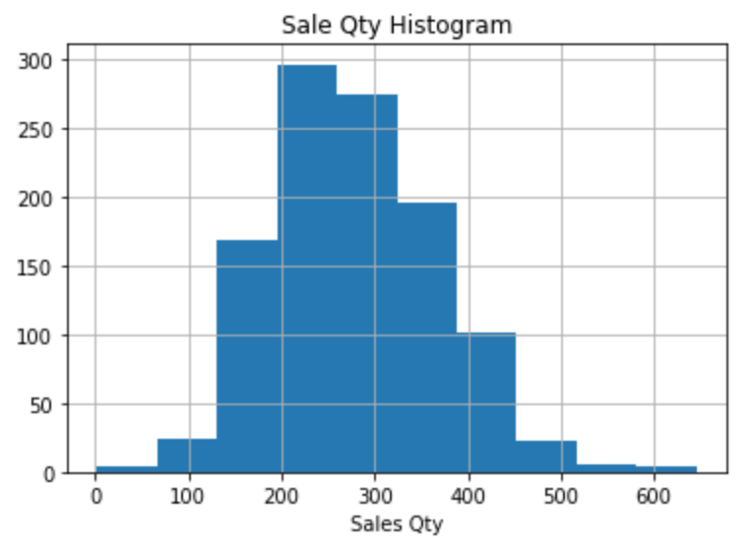
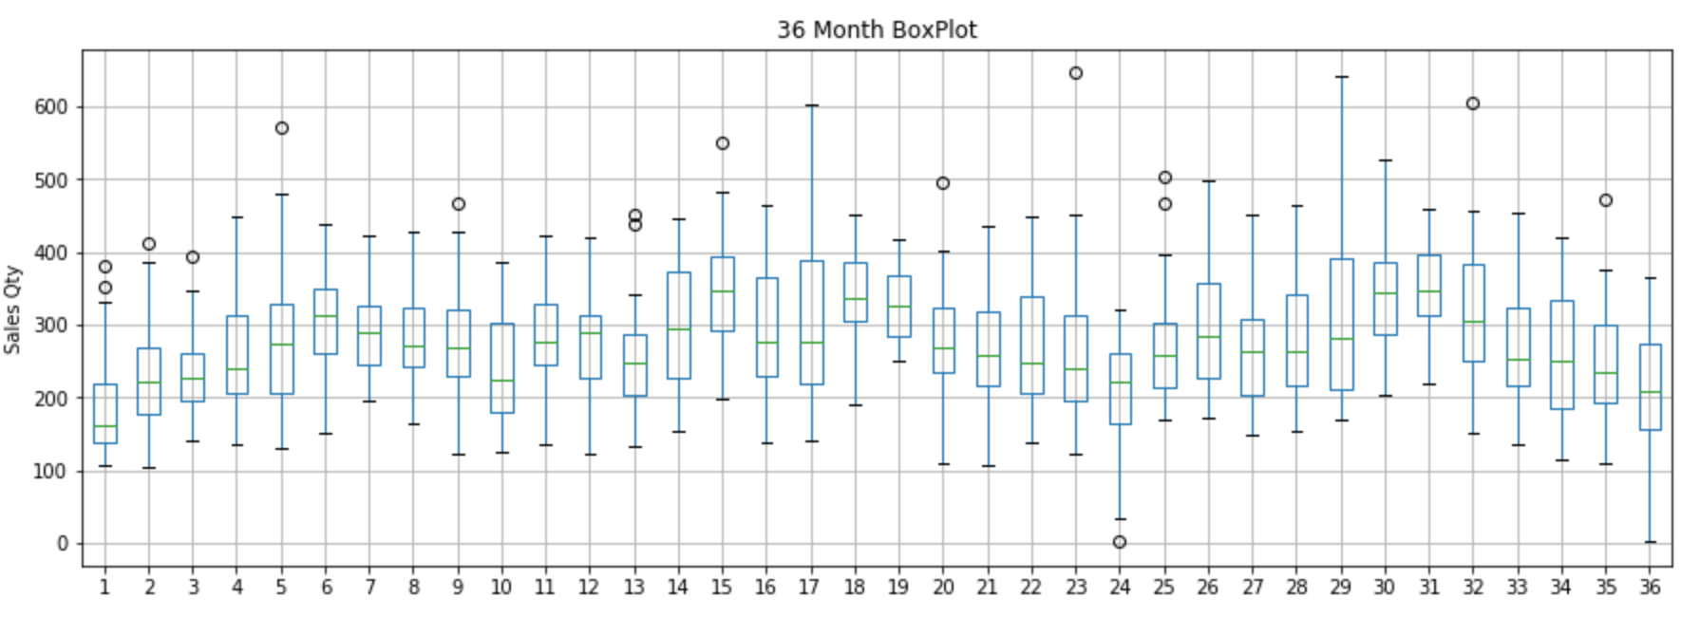
EDA: Years Combined
Target is Normally Distributed
Boxplot shows a moving average & moving variance

Slide 6
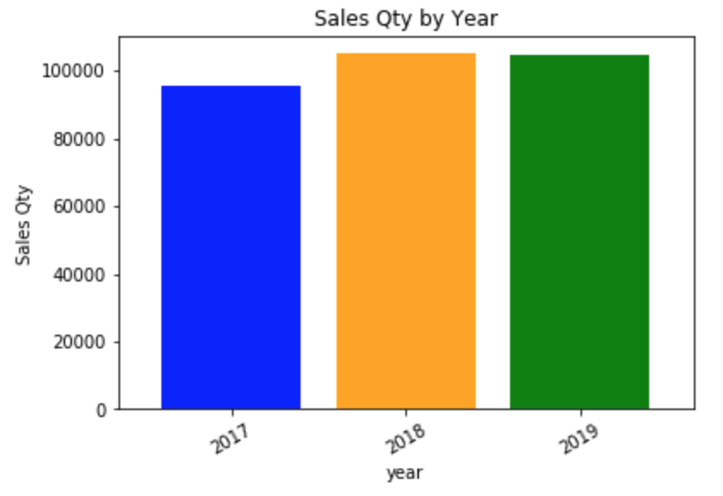
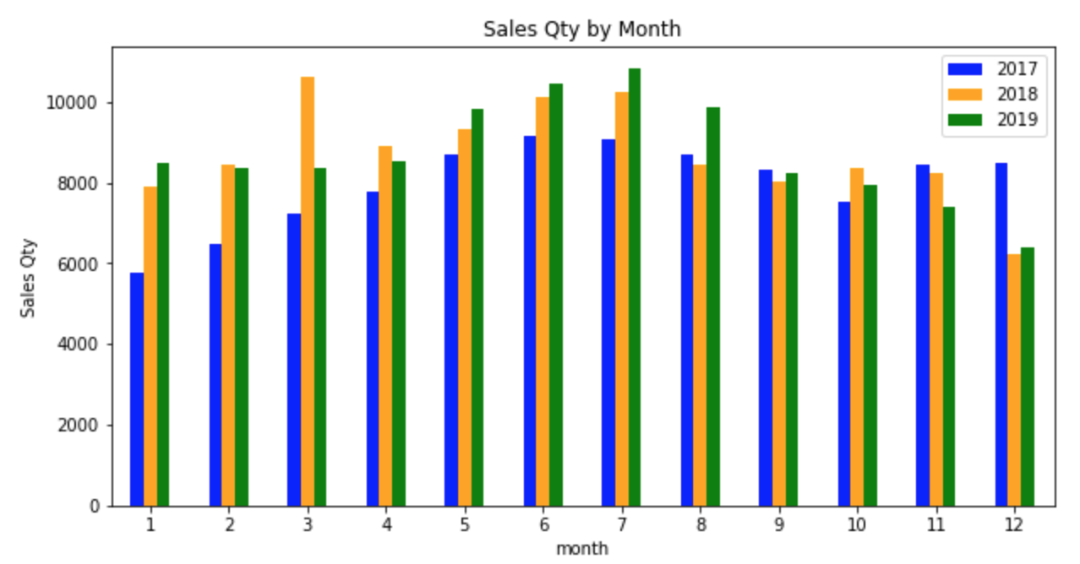
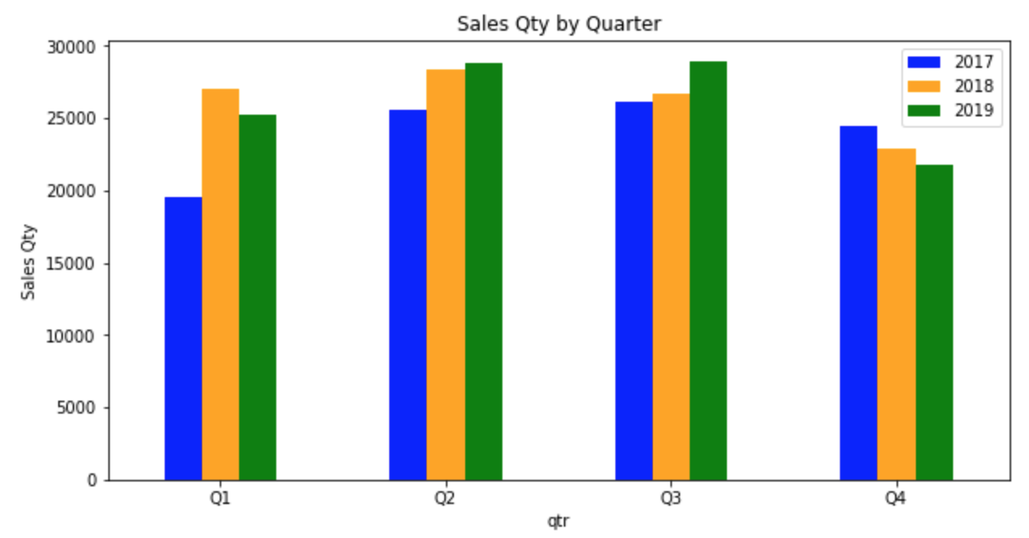
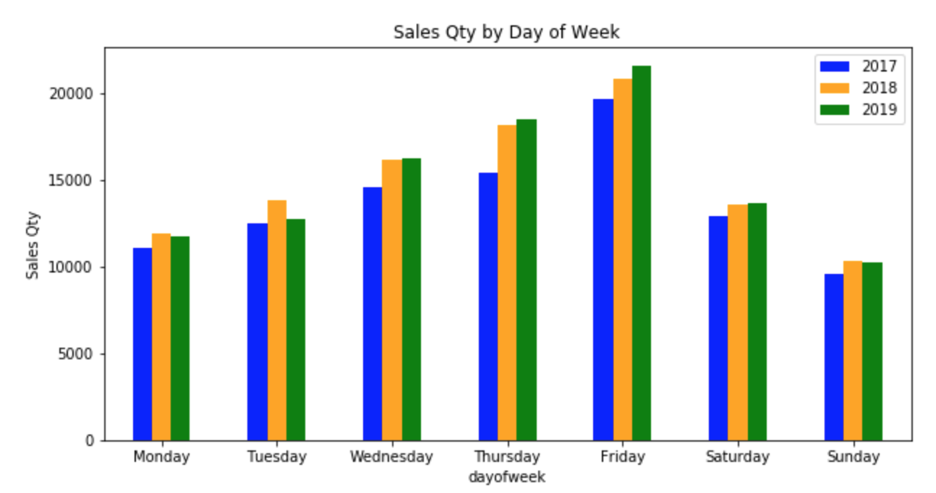
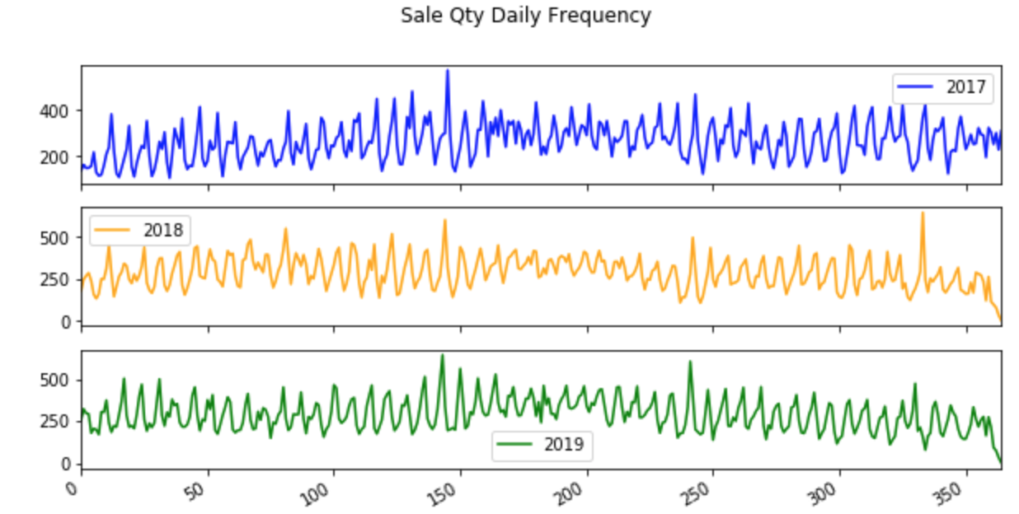
EDA: Years Split

Slide 7
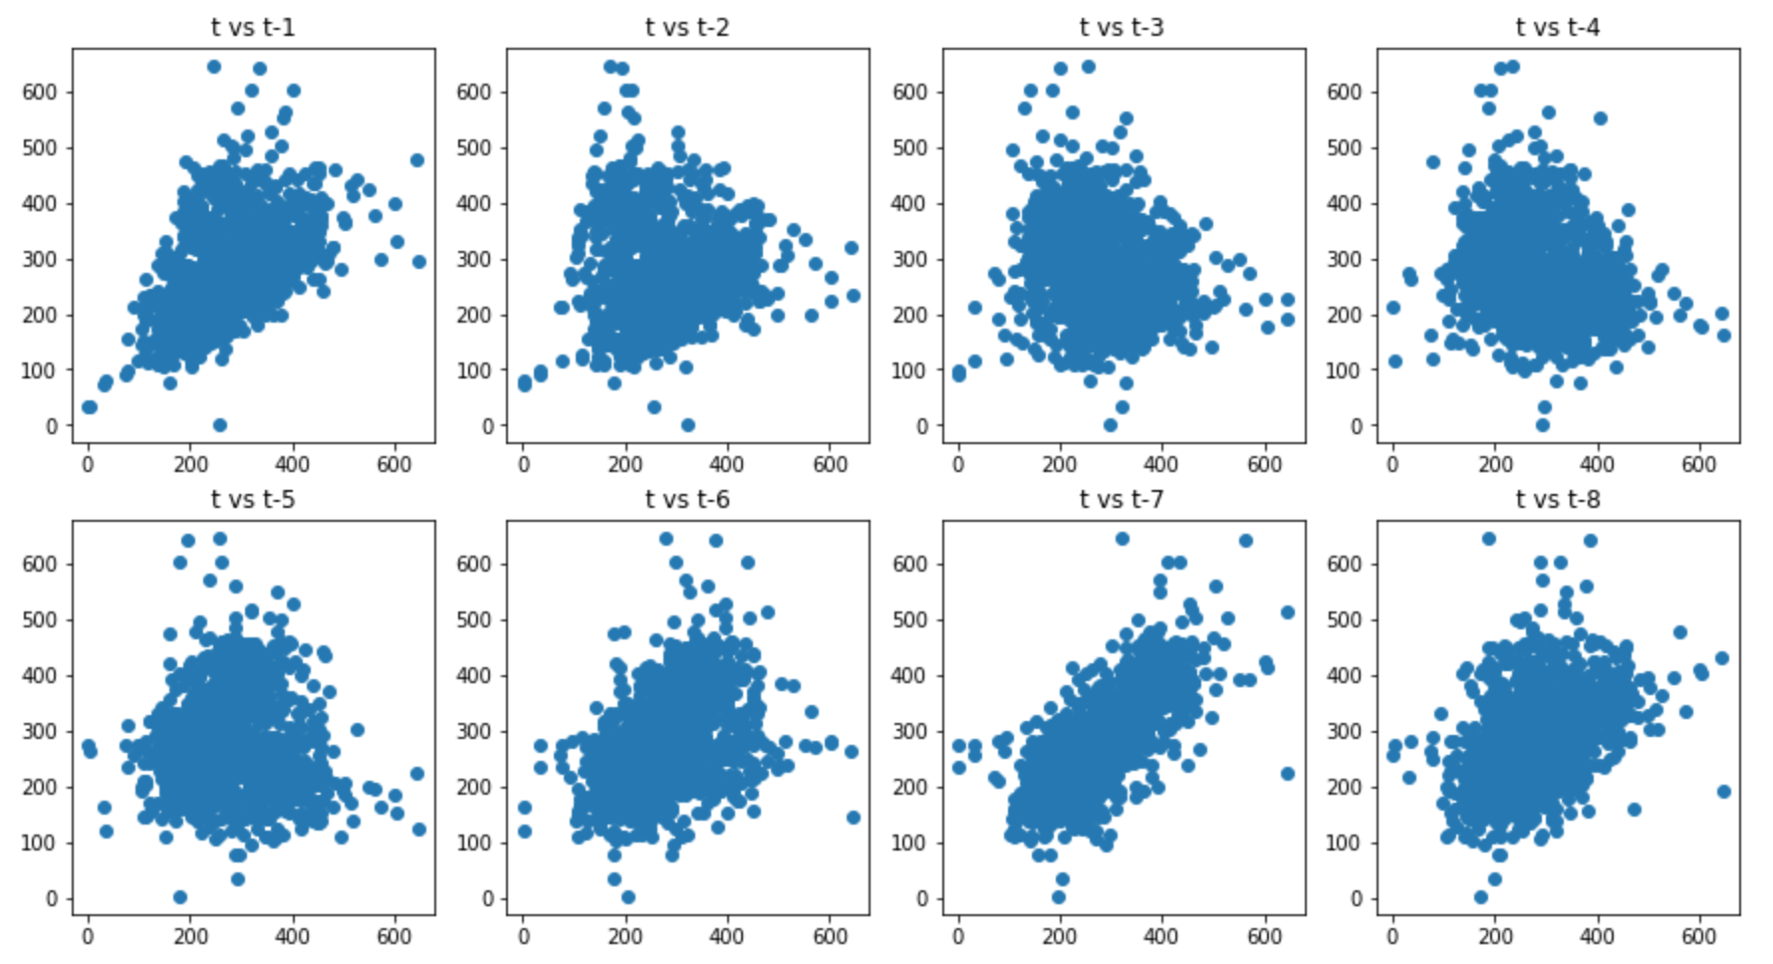
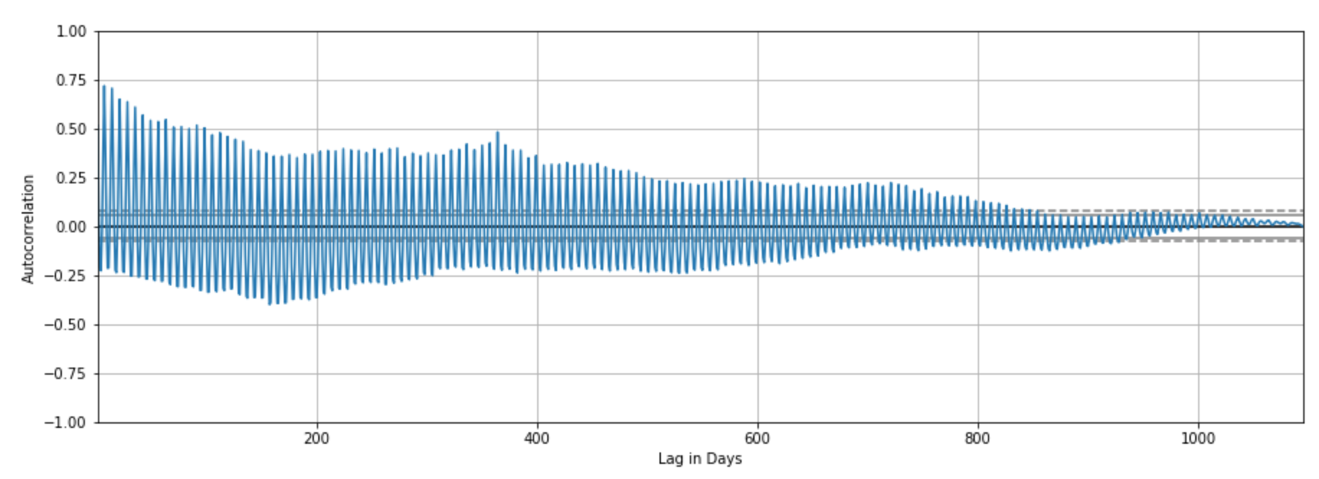
EDA: Time Series
Lag Scatter Plot
Lag 1 has a linear correlation
Lag 7 has a better linear correlation
Autocorrelation Plot
The sine waves are a strong sign of seasonality in the dataset.

Slide 8
Algorithms: Outline
Custom Trailing Moving Average Function (TMA)
ARIMA
fbprophet
LTSM

Slide 9
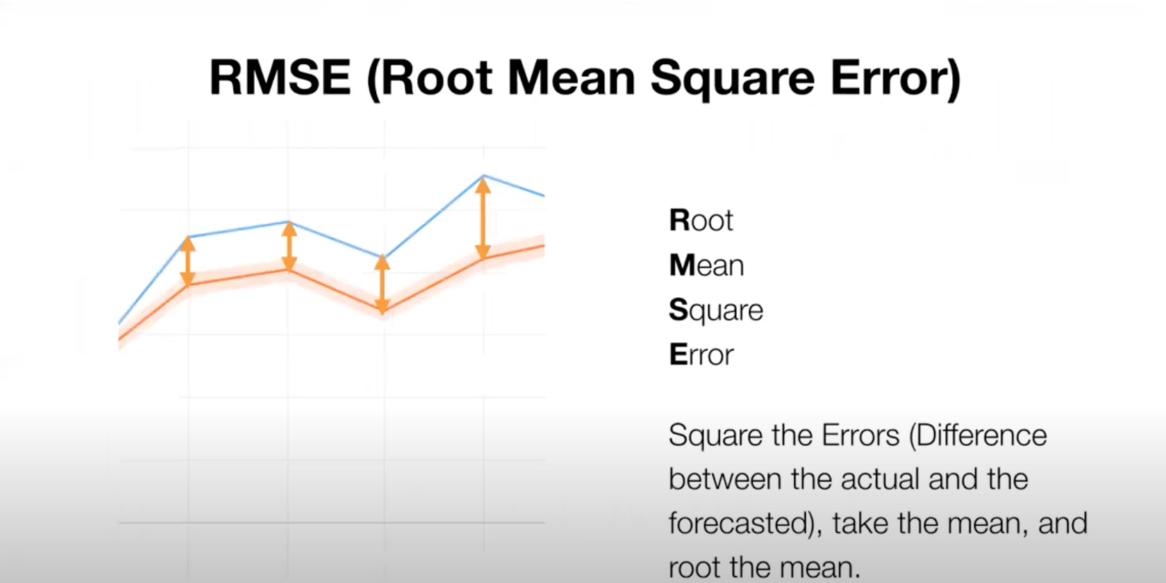
Scoring Metric

Slide 10
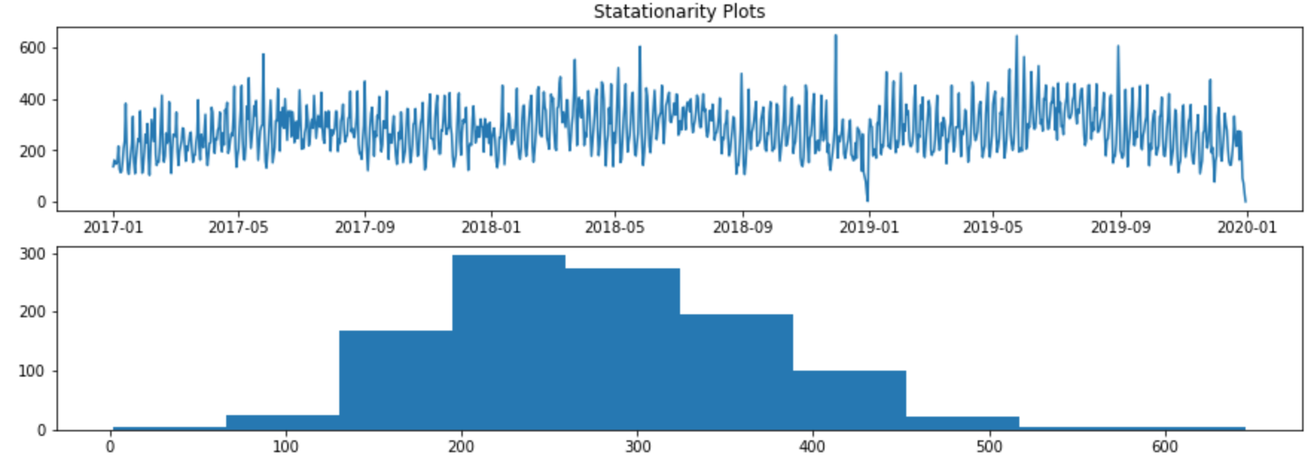
Stationarity Plot: Original Data
The goal is to get the line plot to be a straight line and the histogram to be a Uniform Dist. or Normally Dist.

Slide 11
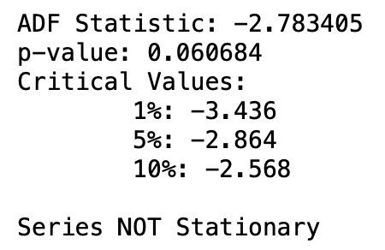
Dickey Fuller Test for Stationarity: Original Data

Slide 12
Moving Average Smoothing
The hope of smoothing is to remove noise and better expose the signal of the underlying causal processes.
Window width- the number of raw observations used to calculate the moving average value.
Two Main Moving Average Types:
Centered Moving Average - cannot use when forecasting
Trailing Moving Average - used on time series forecasting
Data Expectations
Must be Stationary (Both trend and seasonal components have been removed.)

Slide 13
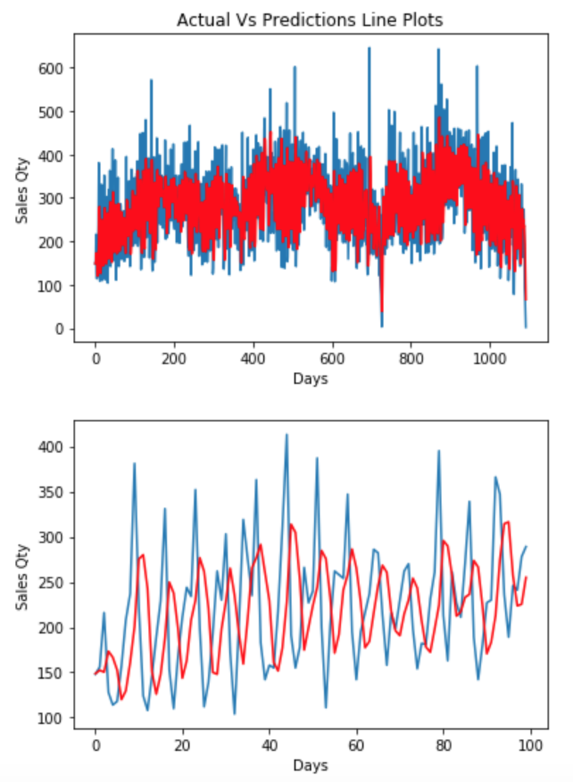
Trailing Moving Average: Base Model
Window Width: 3
Formula:
obs(t) = (1/3) × ( obs(t − 2) + obs(t − 1) + obs(t) )
Original Data:
Test RMSE: 104.059
This is my base model score to beat

Slide 14
Power Transforms
Used the Box-Cox function to find a statistically tuned Lambda value.
Lambda controls the type of transform to perform on data.
lambda = -1.0 is a reciprocal transform
lambda = -0.5 is a reciprocal square root transform
lambda = 0.0 is a log transform
lambda = 0.5 is a square root transform
lambda = 1.0 is no transform
Box-Cox Result: .70
The function choose a square root transformation
The goal is to get the line plot to be a straight line and the histogram to be Uniform or Normally Distributed

Slide 15
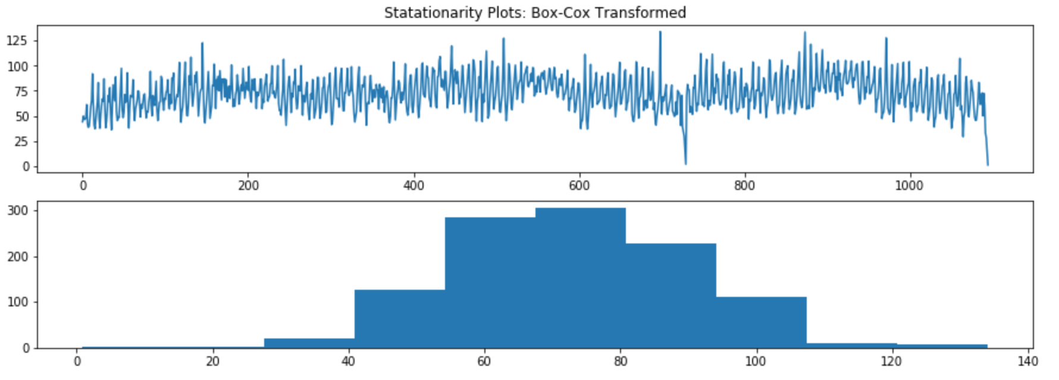
Stationarity Plot: Transformed Data
The line plot looks roughly the same but the histogram looks more Normally Distributed

Slide 16
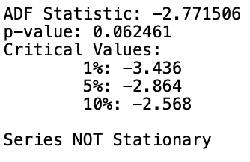
Dickey Fuller Test for Stationarity: Box-Cox Transformed

Slide 17
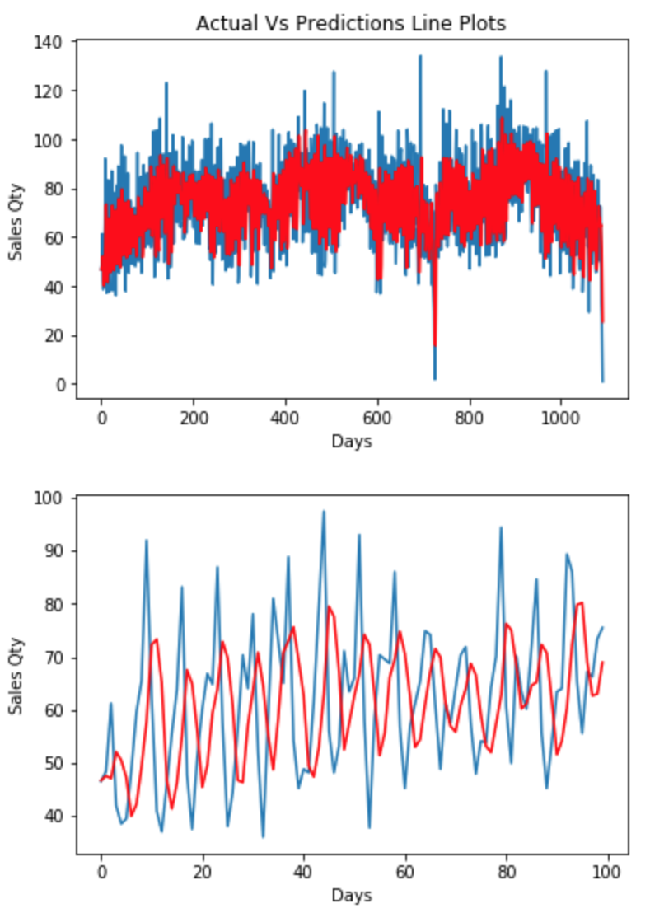
Trailing Moving Average: W/ Box-Cox Transformation
Window Width: 3
Used Box-Cox Transformation
Formula:
obs(t) = (1/3) × ( obs(t − 2) + obs(t − 1) + obs(t) )
Transformed Data: Sqrt
Test RMSE: 19.590^2 = 383.77
Did NOT beat Original model
Not going to use transformation going foward

Slide 18
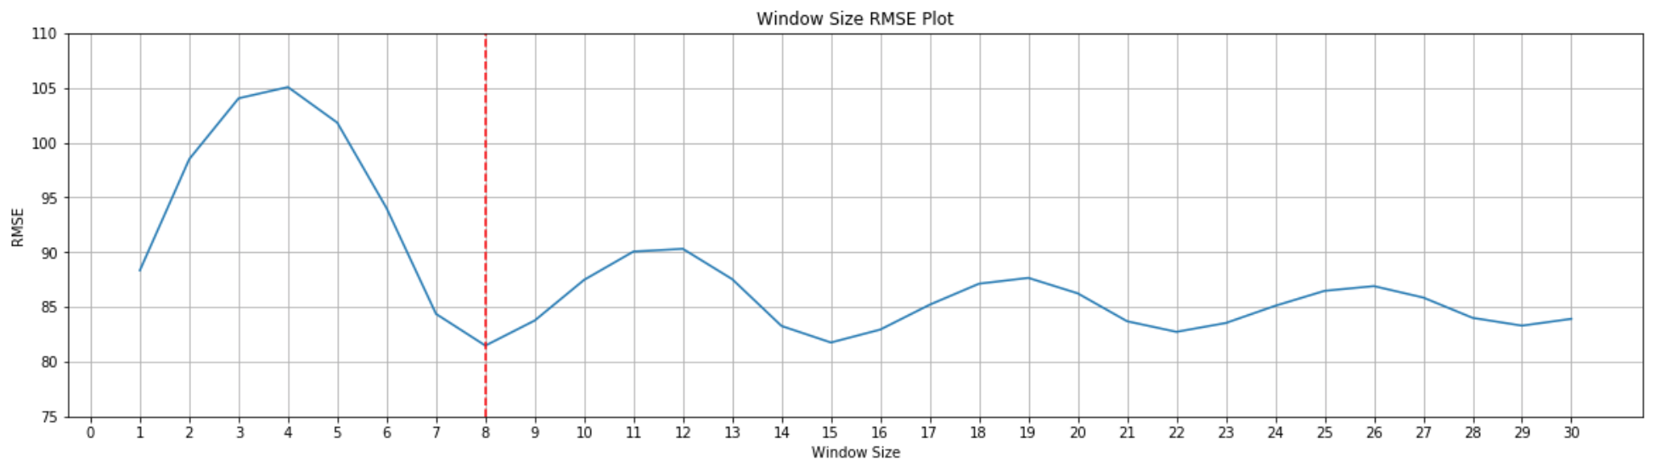
Trailing Moving Average: Window Optimizer
Created a function to Optimize the window size and plot the results
Results:
The Best Window Size is: 8
RMSE Score: 81.47; Beat original model score

Slide 19
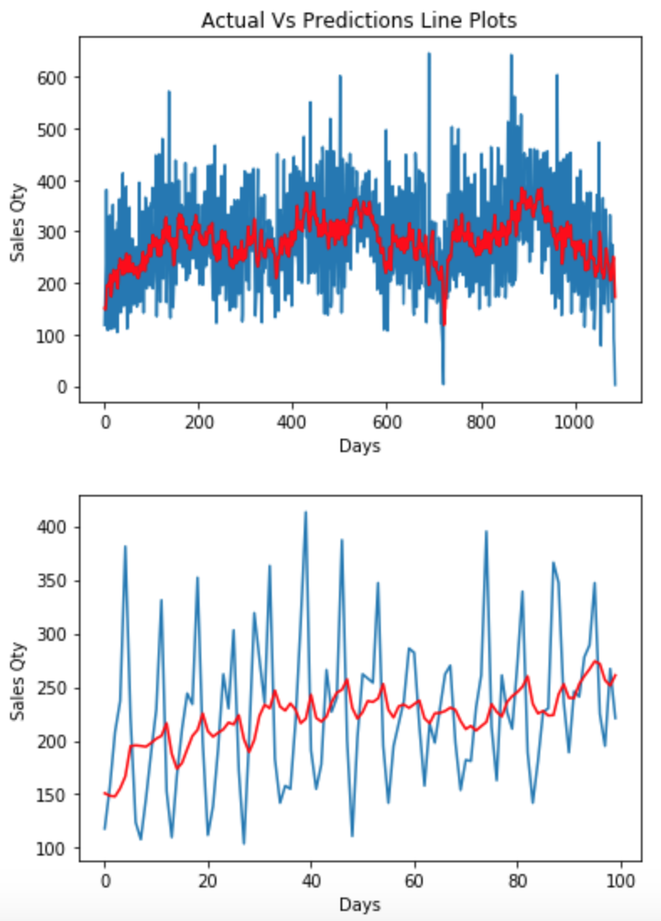
Trailing Moving Average: Window Optimization
Window Width: 8
Formula:
obs(t) = (1/3) × ( obs(t − 2) + obs(t − 1) + obs(t) )
Original Data:
Test RMSE: 81.47
Successfully beat Original model

Slide 20
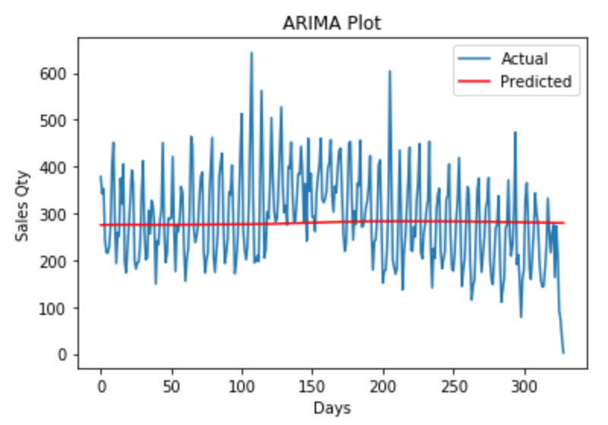
ARIMA: Base Model
Test RMSE:
97.389
Parameters:
p = 0
d = 0
q = 0
Did not capture signal very well.

Slide 21
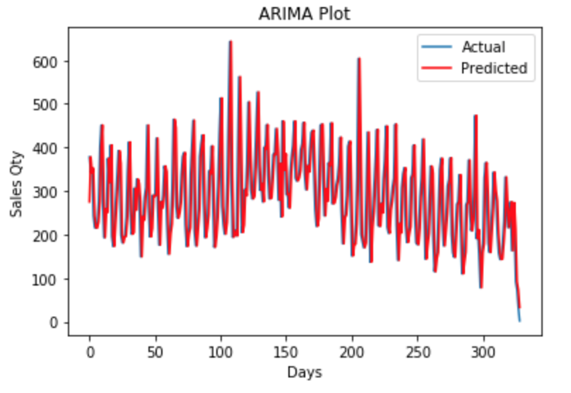
ARIMA: Differenced Model
Test RMSE:
91.025
Parameters:
p = 0
d = 1
q = 0
Captured to much of noise.

Slide 22
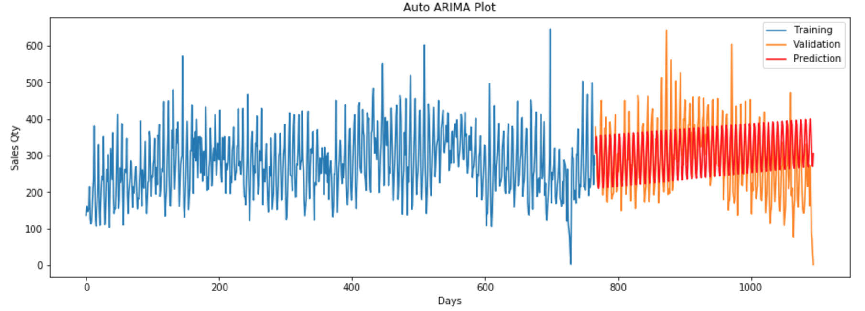
ARIMA: Auto ARIMA Optimizer
Test RMSE:
77.91
Parameters:
p = 5
d = 1
q = 4
OK job capturing signal.

Slide 23
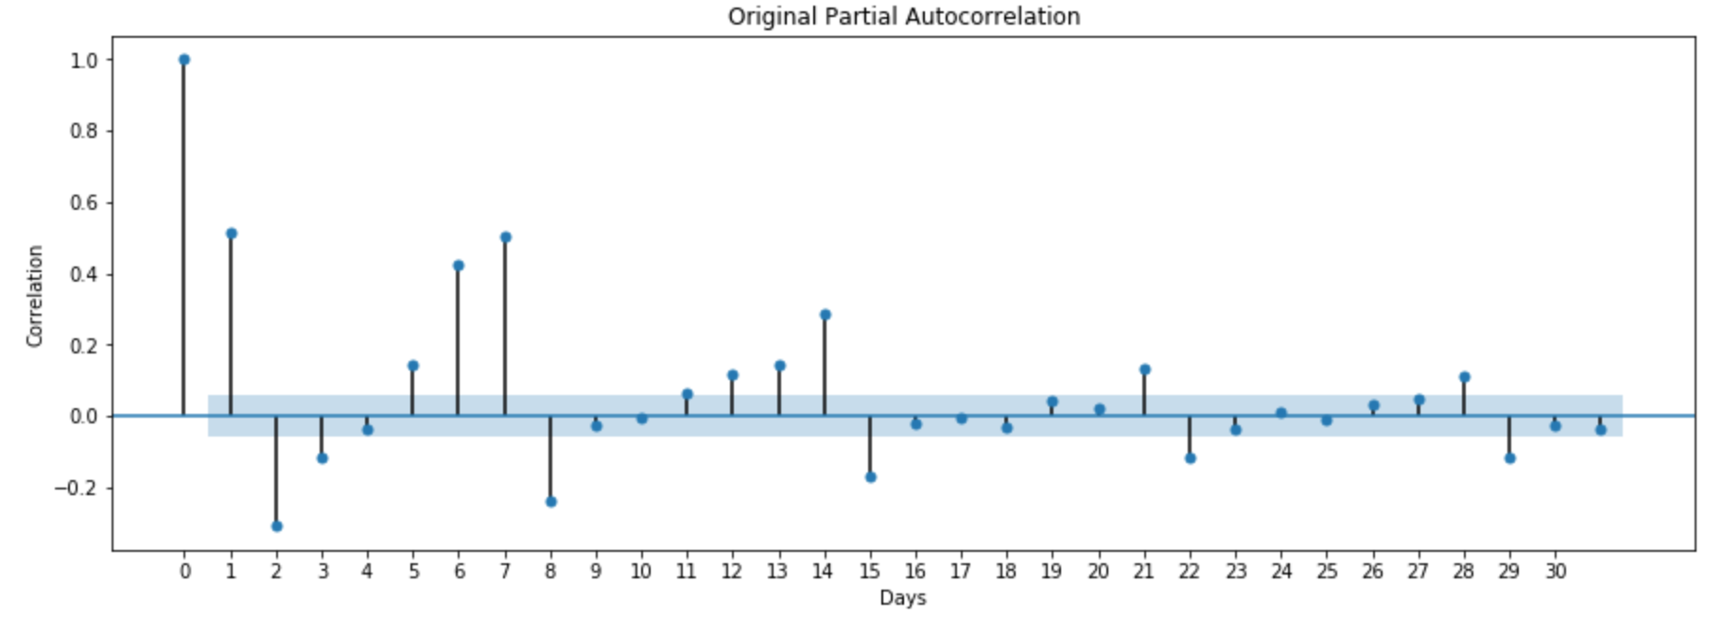
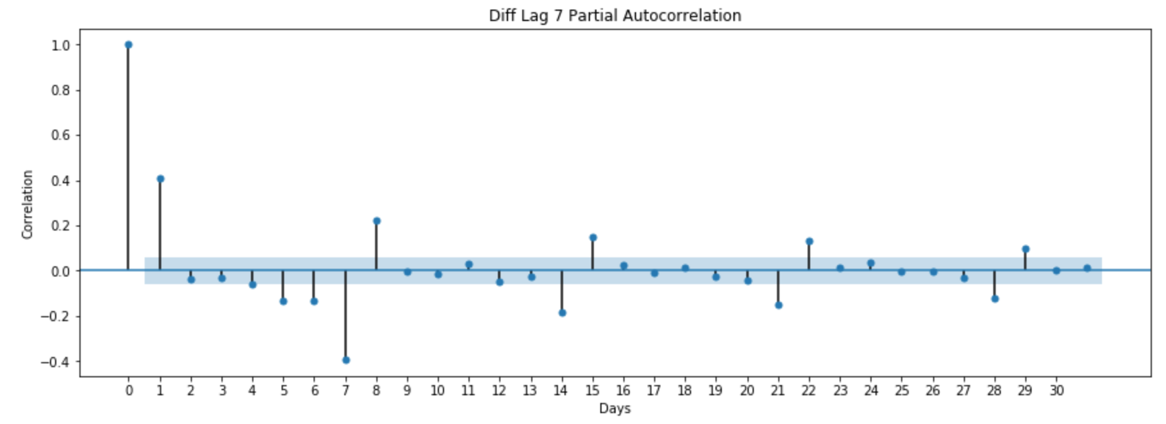
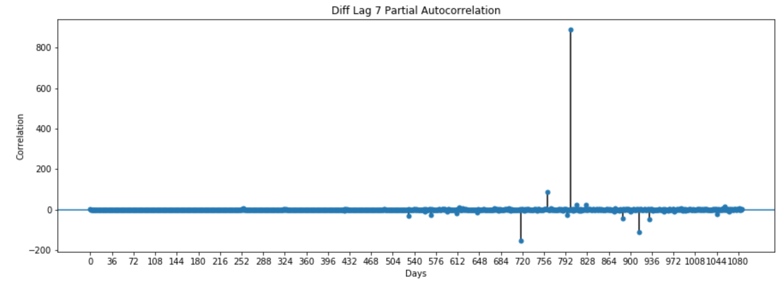
ARIMA: Auto ARIMA, ACF & PACF
ACF & PACF plots show a 7 day seasonality
Differenced series by 7
Ran 7 lag series through Auto ARIMA

Slide 24
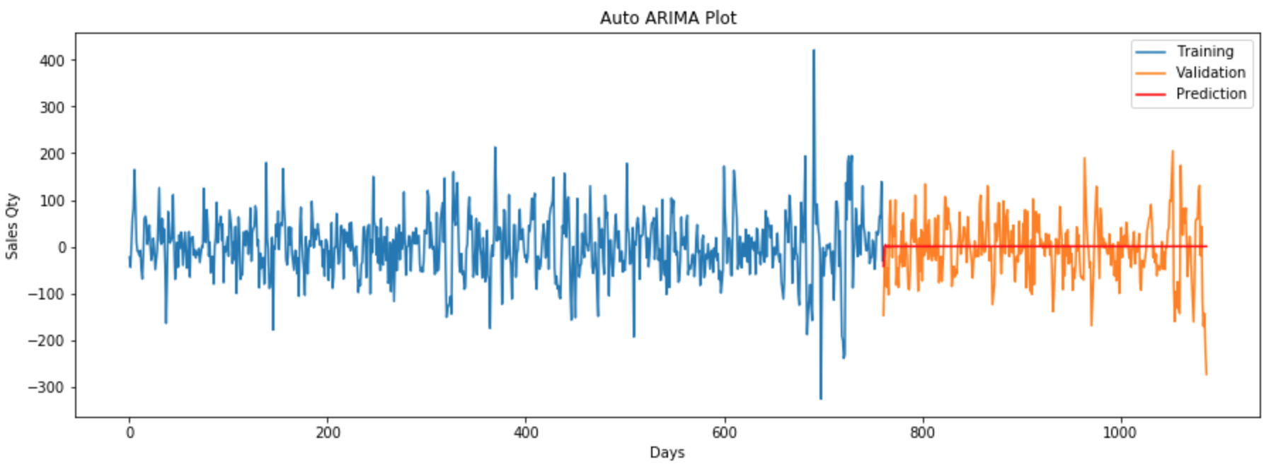
ARIMA: Auto ARIMA Optimizer, ACF & PACF
Test RMSE:
64.90
Parameters:
p = 2
d = 0
q = 3
Time Series Difference Lag 7
Great job capturing signal.

Slide 25
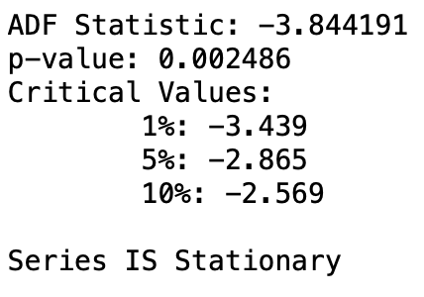
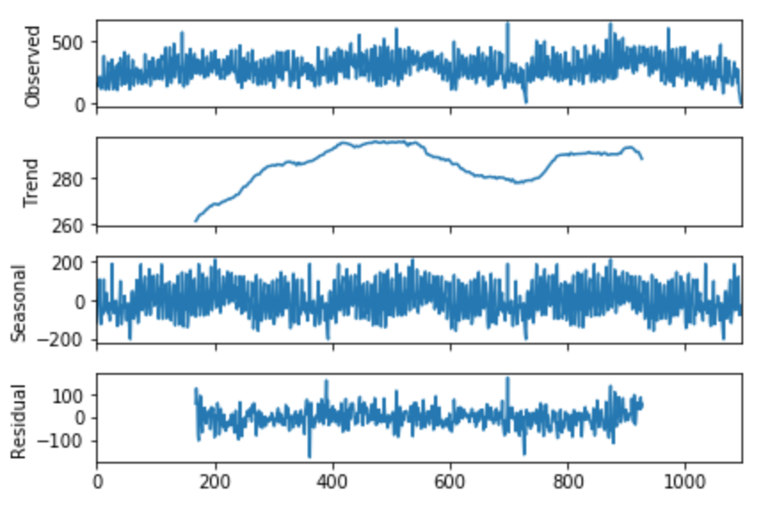
ARIMA: Decompose Series & Test Residuals
Used Lag 7 Data
Decomposed data to show Trend, Seasonality, & Residuals
Applied the Dickey Fuller test on Residuals data.
Residuals passed Dickey Fuller test

Slide 26
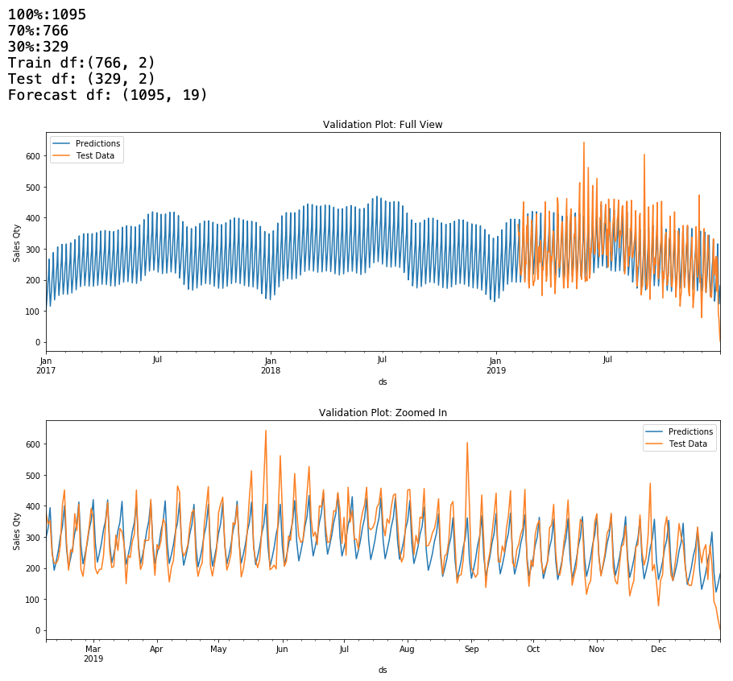
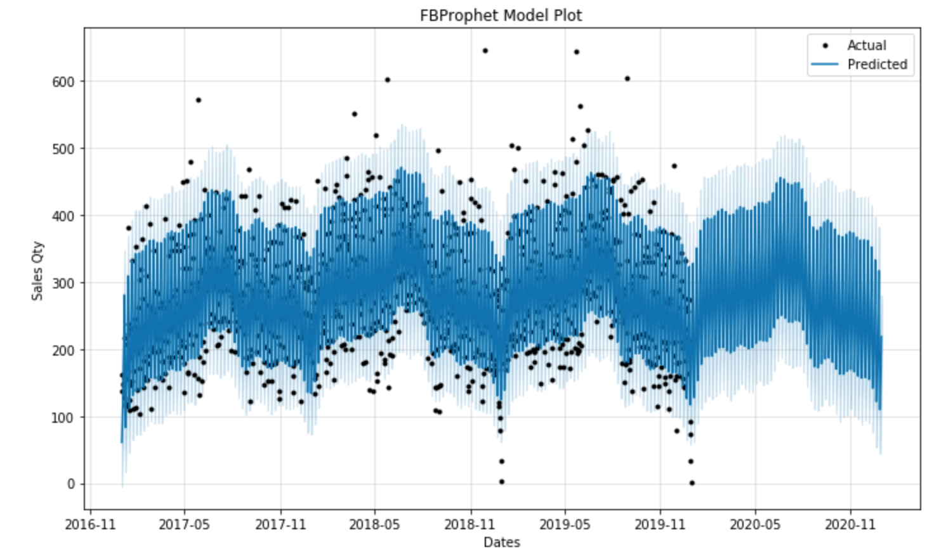
FBProphet: Base Model
Horizon: 180 Days
Daily_seasonality: AUTO Disabled
Base Model RMSE: 56.11

Slide 27
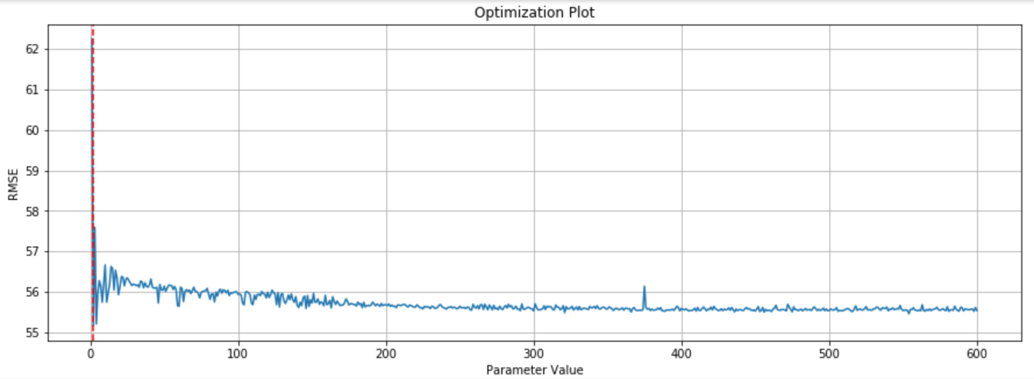
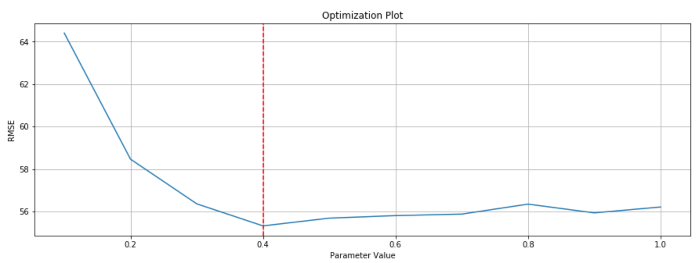
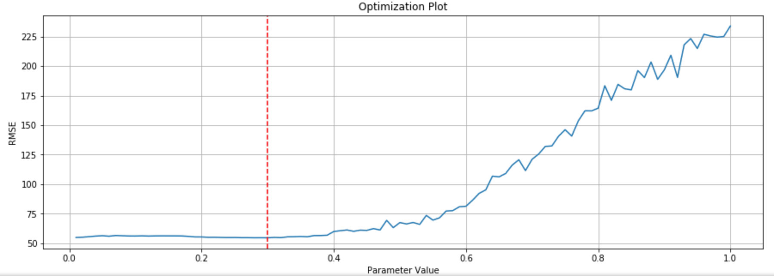
FBProphet: Trend Optimized
n_changepoints
Num Changepoints:
Looped through 600 models
Best Parameter Found: 2
Best RMSE: 55.16
Changepoint Range:
Looped through 10 models
Best Parameter Found: .4
Best RMSE: 55.32
Changepoint Prior Scale:
Looped through 100 models
Best Parameter Found: .3
Best RMSE: 54.57
Optimized RMSE: 55.84
n_changepoints=2
changepoint_range=0.4
changepoint_prior_scale=.3
changepoint_range
changepoint_prior_scale

Slide 28
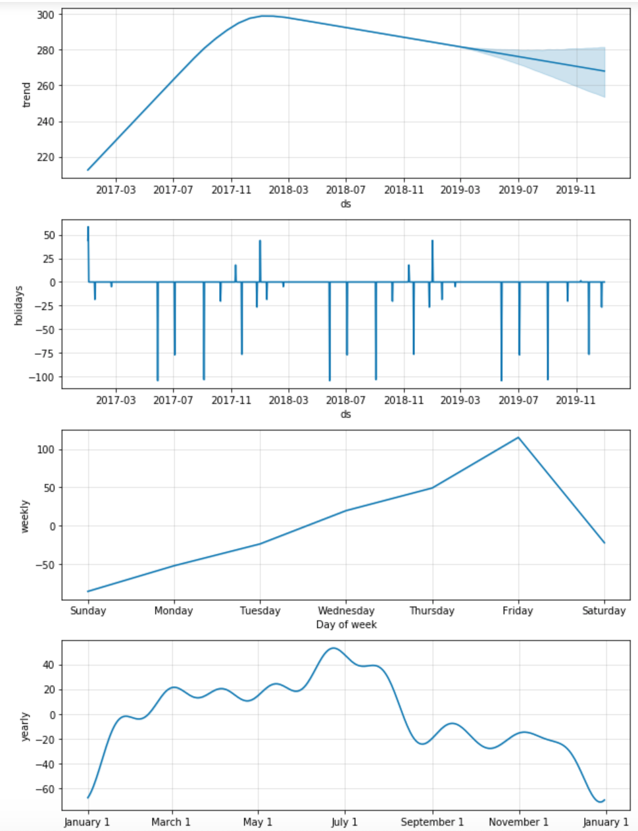
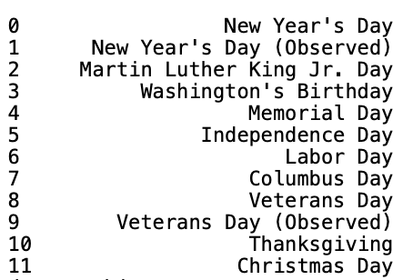
FBProphet: Seasonality & Holiday Optimized
Holiday RMSE: 55.41

Slide 29
Analogy
Progress That Can Be Made
Progress Already Made
Paper Contracts
Hard Copy Files
Digital Database
Human Prediction
Excel
Machine Learning Application

Slide 30
FBProphet: All Parameters Optimized

Slide 31
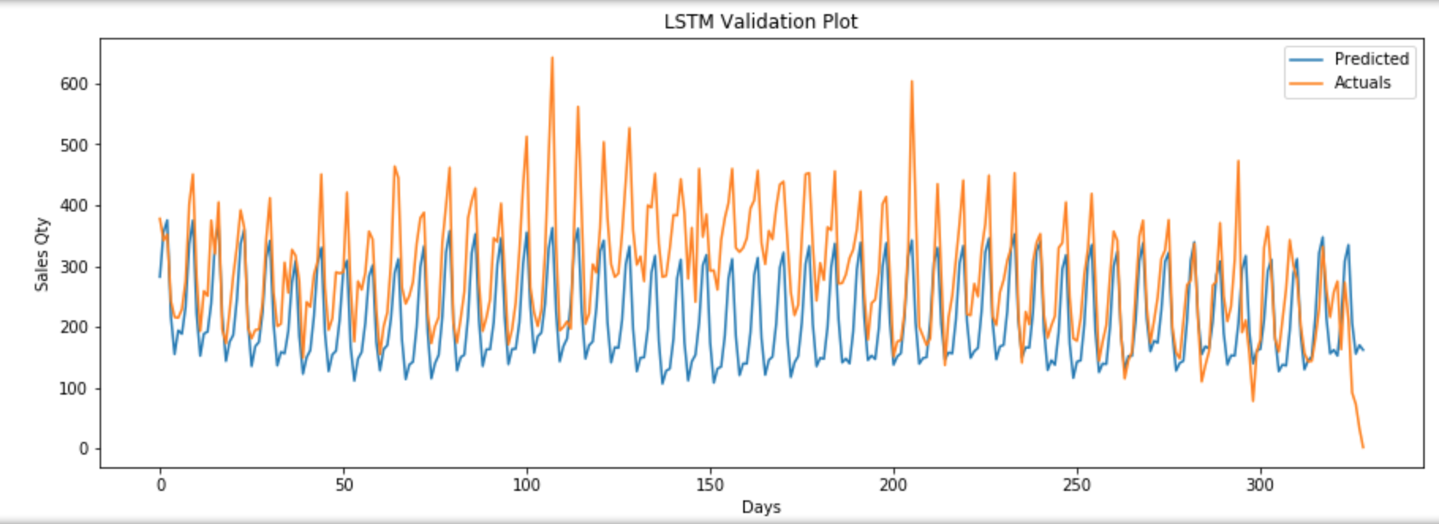
LSTM: Ran on EC2
n_input: 730
LSTM Layers: 2
epochs: 150
Run time: 20 mins
RMSE: 100.67

Slide 32
Algorithms: Results Summary
Custom Trailing Moving Average Function (TMA):
Base Model RMSE: 104.059
Sqrt Model RMSE: 383.77
Optimize Window 8 RMSE: 81.47
ARIMA:
Base Model RMSE: 97.389
Differenced Model RMSE: 91.025
Auto ARIMA Optimizer RMSE: 77.91
ACF/PACF Auto ARIMA RMSE: 64.90
Fbprophet
Base Model RMSE: 65.93
n_changepoints=2 RMSE: 55.16
changepoint_range=.4 RMSE: 55.32
changepoint_prior_scale=.3 RMSE: 54.57
Optimized Combined RMSE: 55.84
US Holiday Seasonallity RMSE: 55.41
LTSM
Base Model RMSE:

Slide 33
If I Had More Time
I would add spring break to and snowboarding peaks to seasonality.
Separate sales demand by location
Separate sales demand by van type
Analyze contract durations

Slide 34
Interpret Results
Does the data answer your original question? How?
Does the data help you defend against any objections? How?
Are there any limitation on your conclusions, any angles you haven’t considered?
Decide your best course of action.

Slide 35
Profit Curve?

Slide 36
White Noise: Explained
A time series is White Noise if the variables are independent and identically distributed with a mean of zero.
If the variables in the series are drawn from a Gaussian distribution, the series is called Gaussian White Noise.
Why Does it Matter?
Predictability: If your time series is white noise, then, by definition, it is random. You cannot reasonably model it and make predictions.
Model Diagnostics: The series of errors from a time series forecast model should ideally be white noise.
Time series data are expected to contain some white noise component on top of the signal generated by the underlying process.
A sign that model predictions are not white noise is an indication that further improvements to the forecast model may be possible.
We can use df.describe() to check if residual data is white noise.
Mean Approx: 0 Standard Dev Approx: 1

Slide 37
White Noise: My Dataset
White Noise Analysis:
My series does NOT have a ZERO MEAN.
The VARIANCE for my series CHANGES over time.
There is a clear CORRELATION with LAG VALUES.
Results:
My series is NOT WHITE NOISE

Slide 38
Random Walk: What is it?
Is my time series data predictable?
A random walk is where the next value in the sequence is a modification of the previous value in the sequence.
We expect a random walk to be non-stationary.
We can make the random walk stationary by taking the first difference.
This difference graph also makes it clear that really we have no information to work with here other than a series of random moves. There is no structure to learn
We recalculate the correlogram of the differenced series.
We want to see no significant relationship between the lagged observations.
Persistence, or the Naive Forecast, is the best prediction we can make for a random walk time series.
Persistence or Naïve Forecast - the best prediction we can make is to use the observation at the previous time step to see what will happen in the next time step.

Slide 39
Random Walk: How to check for it
A Random Walk is one in which future steps or directions cannot be predicted on the basis of past history.
The time series shows a strong temporal dependence that decays linearly or in a similar pattern.
The time series is non-stationary and making it stationary shows no obviously learnable structure in the data.
The persistence model provides the best source of reliable predictions.
Baseline forecasts with the persistence model quickly flesh out whether you can do significantly better.

Slide 40
Decomposition: Explained
Component Types:
Systematic: Components of the time series that have consistency or recurrence and can be described and modeled.
Non-Systematic: Components of the time series that cannot be directly modeled.
Series Components:
Level: The average value in the series. (Systematic)
Trend: The increasing or decreasing value in the series. (Systematic)
A linear trend is a straight line. (Additive Model)
A nonlinear trend is a curved line. (Multiplicative Model)
Seasonality: The repeating short-term cycle in the series. (Systematic)
A linear seasonality has the same frequency (width of cycles) and amplitude (height of cycles). (Additive Model)
A nonlinear seasonality has an increasing or decreasing frequency and/or amplitude over time. (Multiplicative Model)
Noise: The random variation in the series. (Non-Systematic)

Slide 41
Trend
A trend is a long-term increase or decrease in the level of the time series.
It is a systematic change in a time series that does not appear to be periodic is known as a trend.
Faster Modeling: Perhaps the knowledge of a trend or lack of a trend can suggest methods and make model selection and evaluation more efficient.
Simpler Problem: Perhaps we can correct or remove the trend to simplify modeling and improve model performance.
More Data: Perhaps we can use trend information, directly or as a summary, to provide additional information to the model and improve model performance.
Types of Trends:
Deterministic Trends: These are trends that consistently increase or decrease.
Stochastic Trends: These are trends that increase and decrease inconsistently.
Global Trends: These are trends that apply to the whole time series.
Generally, global trends are easier to identify and address.
Local Trends: These are trends that apply to parts or subsequences of a time series.

Slide 42
Seasonality
This is a cycle that repeats over time, such as monthly or yearly.
This repeating cycle may obscure the signal that we wish to model when forecasting, and in turn may provide a strong signal to our predictive models.
Seasonal variation, or seasonality, are cycles that repeat regularly over time.
A repeating pattern within each year is known as seasonal variation, although the term is applied more generally to repeating patterns within any fixed period.
If it consistently repeats at the same frequency, it is seasonal, otherwise it is not seasonal and is called a cycle.
Clearer Signal: Identifying and removing the seasonal component from the time series can result in a clearer relationship between input and output variables.
More Information: Additional information about the seasonal component of the time series can provide new information to improve model performance.
Extracting seasonal information and providing it as input features, either directly or in summary form, may occur during feature extraction and feature engineering activities.

Slide 43
Seasonality
Types of Seasonality
Time of Day
Daily
Weekly
Monthly
Yearly
Deseasonalizing:
Identify Seasonality
Model the Seasonality
Remove Seasonality from series
Seasonal Adjustment Two Methods:
Differencing: subtract the prior period of cycle type.(EX: dayofweek)

Slide 44
Decomposition: Applied

Slide 45
Feature Engineering
The goal of feature engineering is to provide strong and ideally simple relationships between new input features and the output feature for the supervised learning algorithm to model.
The difficulty is that we do not know the underlying inherent functional relationship between inputs and outputs that we’re trying to expose.

Slide 46
Motivation(IDEA)
Design Flow chart showing Motivation

Slide 47
Pipeline

